Slide 1

window boot process

Slide 2

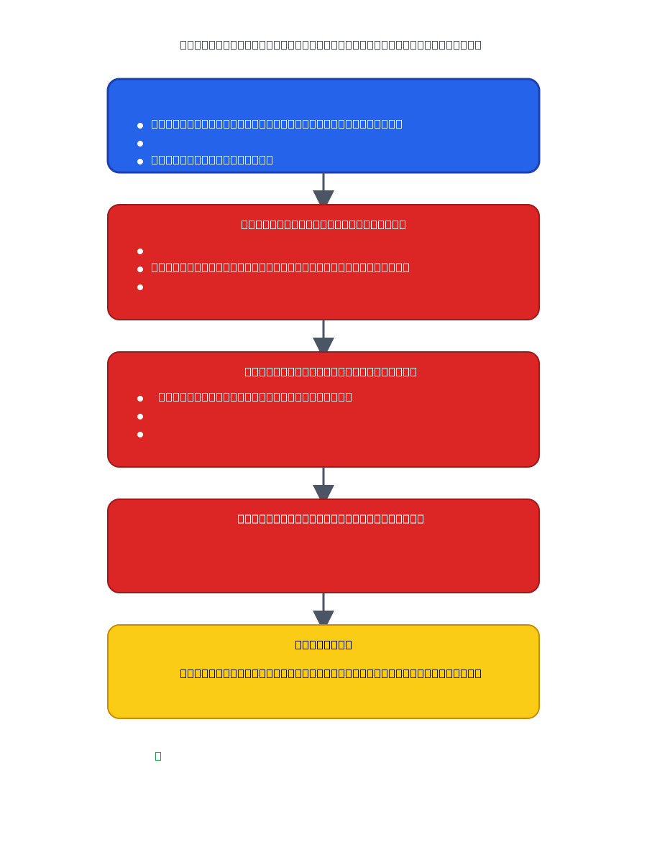

Slide 3

window process tree

Slide 4

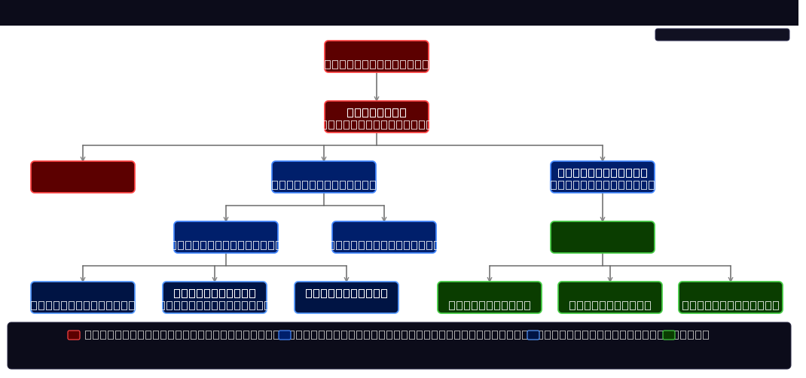

Slide 5

window security ring’s

Slide 6
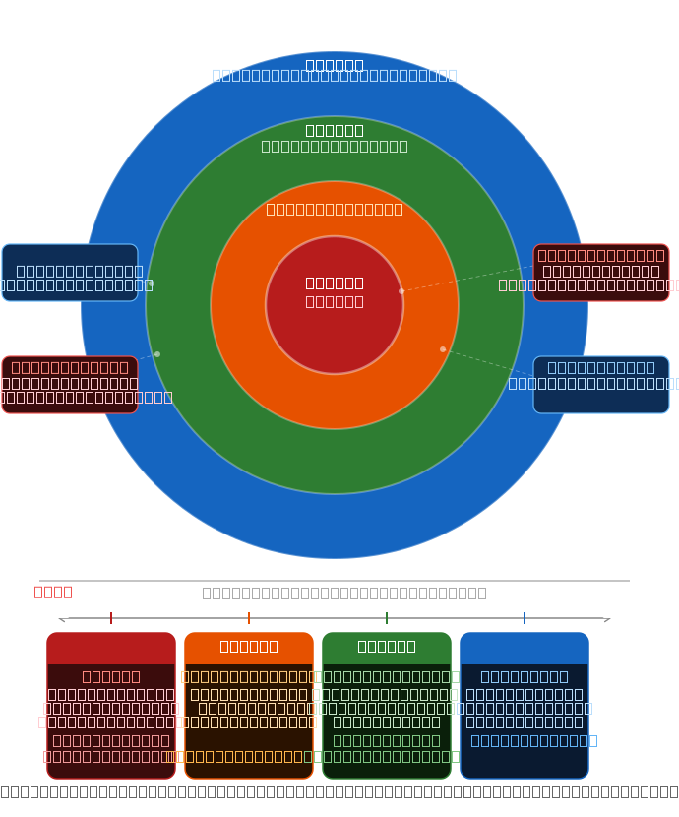


Slide 7

window architecture

Slide 8
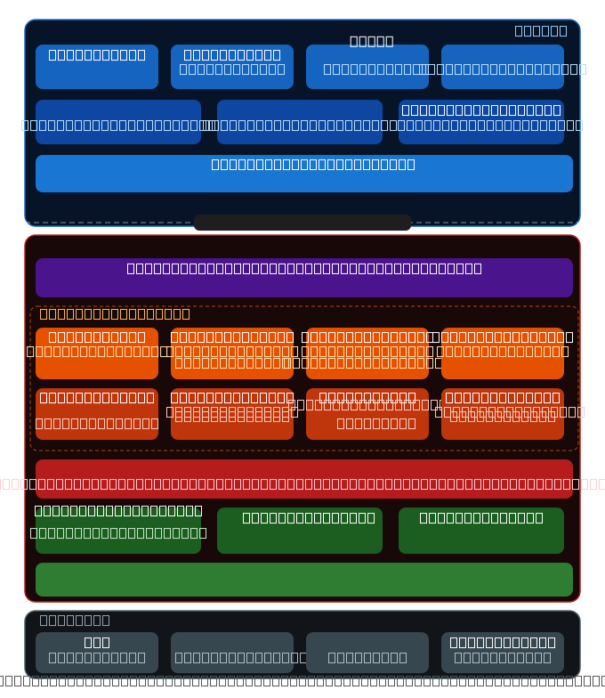


Slide 9

window Api

Slide 10
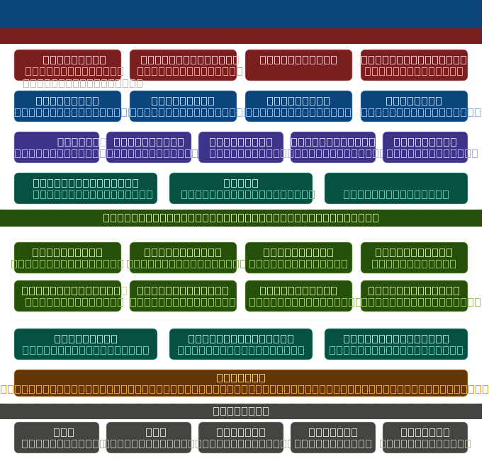

Slide 11

window syscall architecture

Slide 12
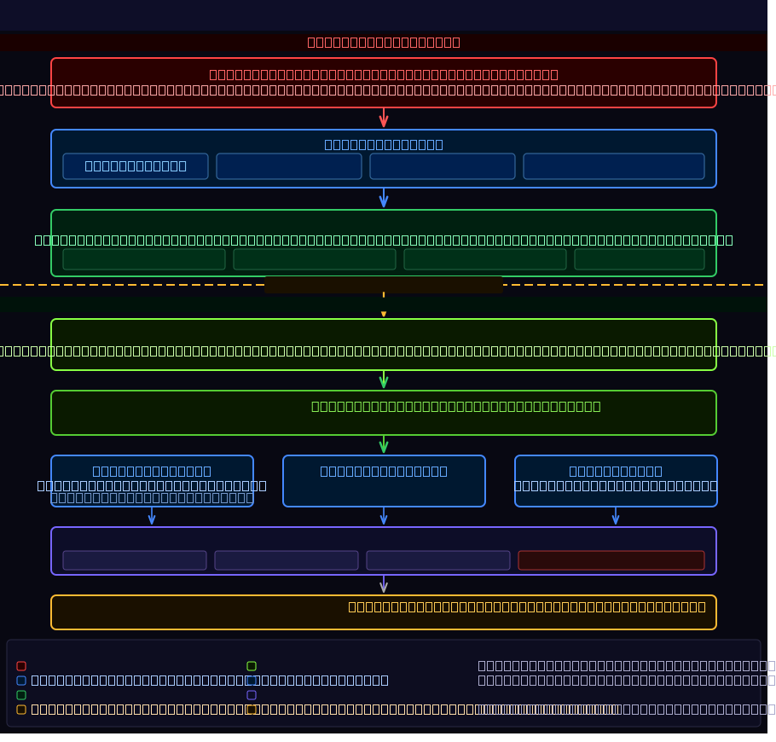

Slide 13

user space vs kernal space

Slide 14
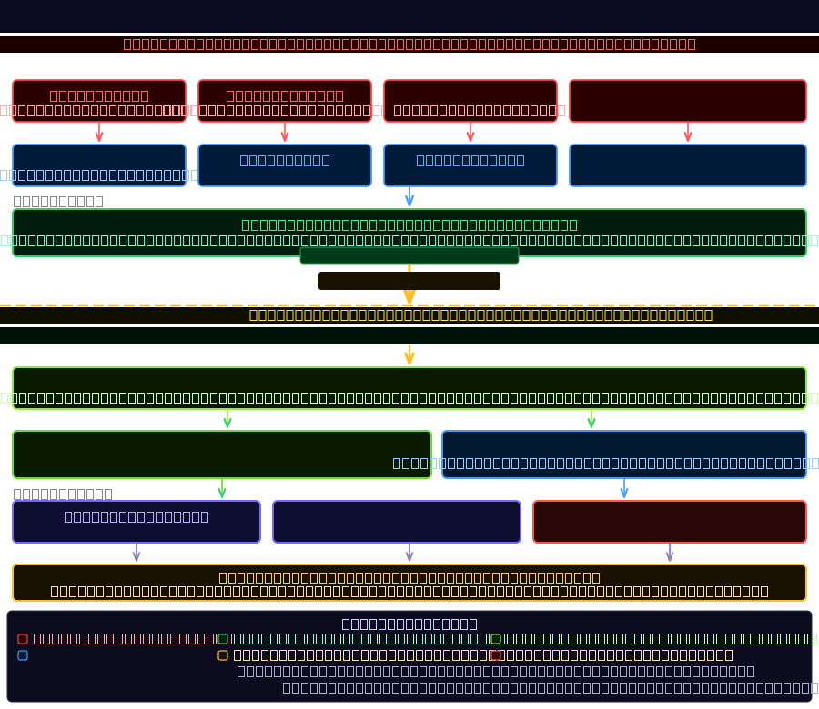

Slide 15

window memory management

Slide 16
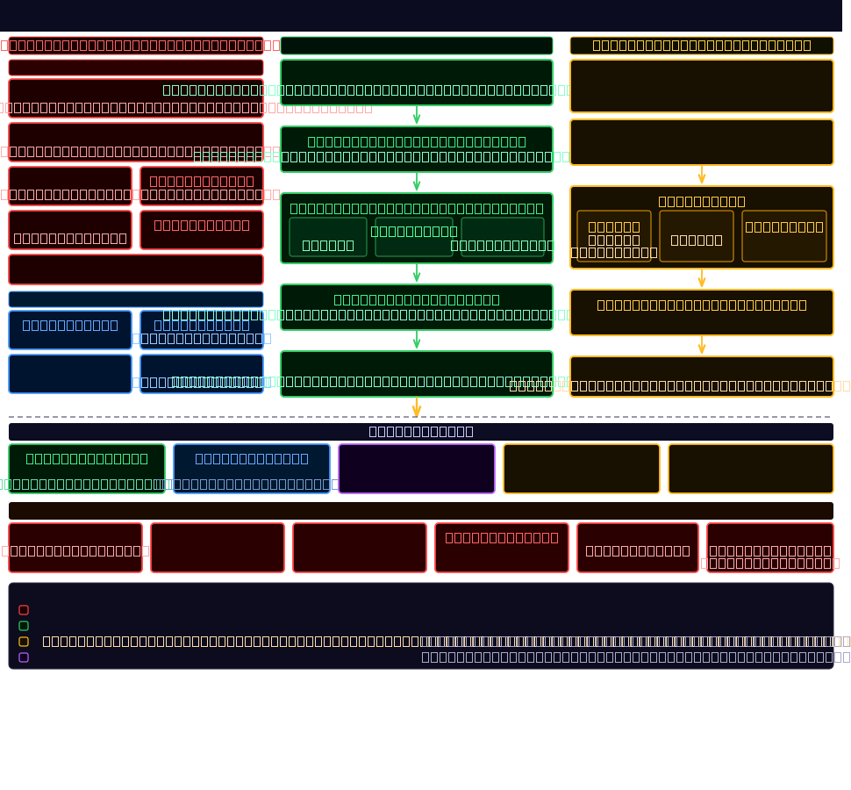

Slide 17

window messages

Slide 18
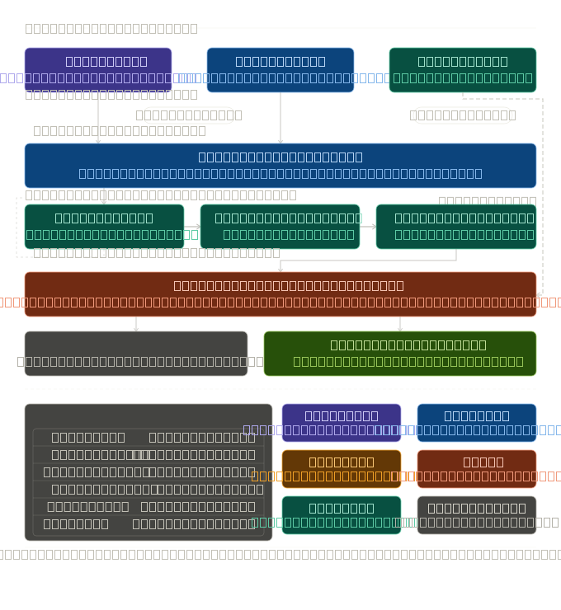

Slide 19

window trap dispatch

Slide 20
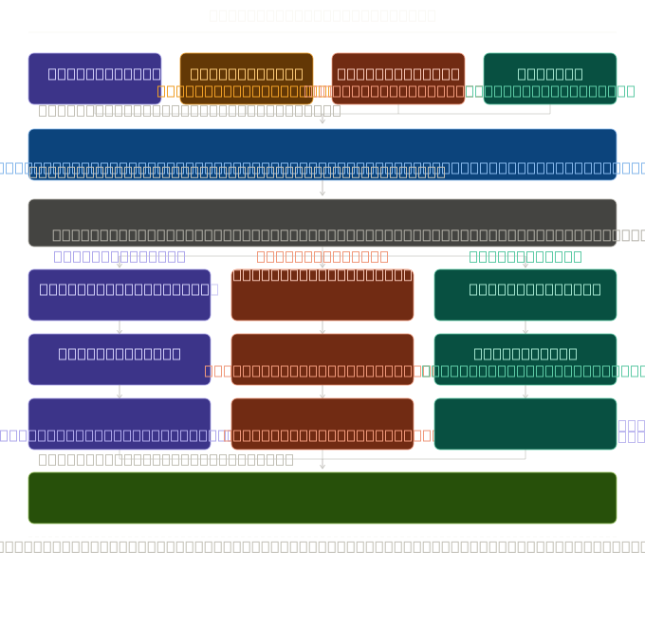

Slide 21
window job objects

Slide 22
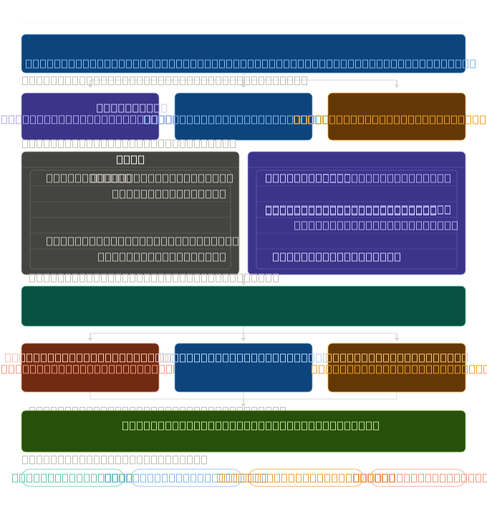

Slide 23
window timer process

Slide 24
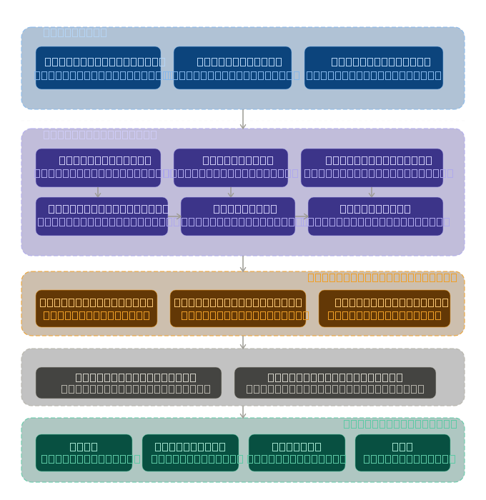

Slide 26
